Slide 1
Blood cells
Hematology
RED

Slide 2
Blood consists of:
Cells :
RBC (erythrocytes)
WBC (leukocytes)
Platelets (thrombocytes)
Plasma.
Plasma 55%
WBC
Hematocrit 45%

Slide 3
Synthesis of red blood cells –RBCs- (Erythropoiesis)

Slide 4
Pluripotent Hemopoietic stem cell
Growth Factors
Committed proginator cell
Erythropoietin
Proerythroblast
Bone marrow
4-5 days
Early normoblast
Intermediate normoblast
Late normoblast
Reticulocyte
Blood
1-2 days
Erythrocyte
Notes:
Cell division until late ery then rest matures
important effect of erythropoietin is to stimulate the production of proerythroblasts from hematopoietic stem cells in the bone marrow. In addition, once the proerythroblasts are formed, the erythropoietin causes these cells to pass more rapidly through the different erythroblastic stages than they normally do, further speeding up the production of new red blood cells

Slide 5
Erthropoietin
Is a hormone secreted from Kidneys
(> 90% )
It stimulates self replication and proliferation of erythrocyte stem cells.
Secretion is stimulated by hypoxia.

Slide 6
Nutritional requirements for red cell production
Amino acids.
Iron.
Vitamins:
Vit B12
Folic acid
Vit B6
Vit C
Vit E
Trace elements: Zn, Cu, Co,,,

Slide 7
Iron Distribution:
Total amount in the body 3-5 g
Hb 65-75% (3g)
Storage 20% (1g)
Cellular 3% (150mg)
Transport 1% (3-4mg)

Slide 8
The average diet provides 10-20 mg/day.
Sources:
Animal products: meat, liver, eggs .
Plant products: leafy vegetables, cereals.
Note: milk & milk products does not contain any iron.

Slide 9
Daily requirements:
1mg/day in an adult male
2mg/day in an adult female
Increase during :
Pregnancy
Lactation
Infancy

Slide 10
Absorption:
Site: duodenum & upper jejunum.
Converted from ferric to ferrous by Vit. C.
Only 10 – 20% is absorbed.

Slide 11
Factors affecting iron absorption:
Increase:
Ferrous state (Fe ⁺² )
Gastric acidity ( HCl ) , maintains iron in the ferrous state ,
Vitamin C.

Slide 12
Decrease:
Presence of thalates, phosphates or oxalates in the diet.
Achlorohydria
Diarrhoea

Slide 13
Transport:
By transferrin in the ferric state.
Storage:
In the reticuloendothelial cells.
In 2 forms:
2/3 as ferritin
1/3 as hemosiderin

Slide 14
Excretion:
Is shed in:
Intestinal cells in feces.
Hair.
Nails.
Skin cells.
Sweat.

Slide 15
Hemoglobin synthesis
Gly
Succinyl Co A
Iron ( Fe 2+)
Porphyrin
Amino acids
4
HEME
Globins
4
HEMOGLOBIN
Notes:
Synthesis of hemoglobin begins in the proerythroblasts and continues even into the reticulocyte stage of the red blood cells

Slide 16
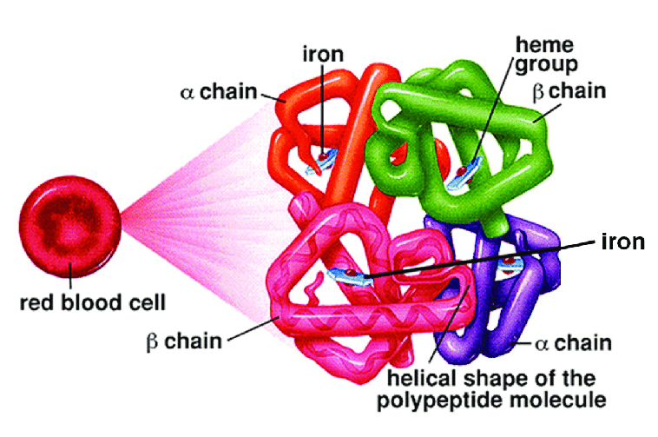

Slide 17
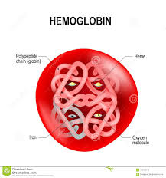

Slide 18
Types of Hb:
Hb A = 2α 2β
Hb A2 = 2α 2δ
Hb F = 2α 2ϒ
Hb A1c
96%
3%
1%

Slide 19
Functions of Hb:
Oxygen binds with iron in heme forming oxyhemoglobin.
Carbon dioxide binds with globin chains forming carbaminohemoglobin.
Protein buffer.

Slide 20
Hb normal values:
14-16g/dl in males
13-15g/dl in females
18-20g/dl in neonates

Slide 21
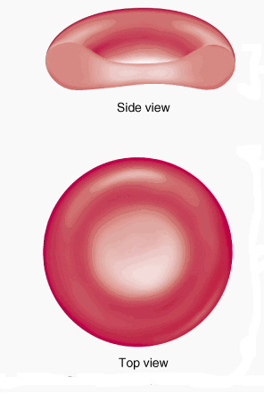
Structure of RBC
Aneucleated.
Biconcave shape.
Dimensions:
Diameter = 8 micrometer
Thickness = 1-2 micromtr
Surface area = 138 sq. micromtr
Volume = 90 femtoliter
Life span = 120 days
Notes:
No ncl no ptn no mitc ribs use glycolsis synt rpar lifespan

Slide 22
Importance of biconcave shape:
Oxygen diffusion.
Deformability.
Better osmotic fragility.

Slide 23
Normal RBC count:
4.5 – 6 million/micro L in adult male.
4 – 5.5 million/micro L in adult female.
6 – 8 million/micro L in a newborn.

Slide 24
RBC breakdown
Destructed in the reticuloendothelial system (mainly spleen).
The cell becomes old and abnormally shaped.

Slide 25
RBC
HEME
Globin
RES
Porphyrin
Fe ⁺²
aa
Reused
Bilivirdin
Blood
Albumin
Bilirubin
Water insoluble (unconjugated)
Glucouronyltransferase
Liver
Glucouronic acid
Bilirubin
Water soluble (conjugated)
Bacterial
action
Kidneys
Bile& small intestines
Enterohepatic
stercobilinogen
urobilinogen
(colorless)
(Brown)

Slide 26
Jaundice
Is the yellow discoloration of the skin & sclera. Due to excess accumulation of bilirubin in plasma.
Normal:
0.5 – 1mg/dl

Slide 27
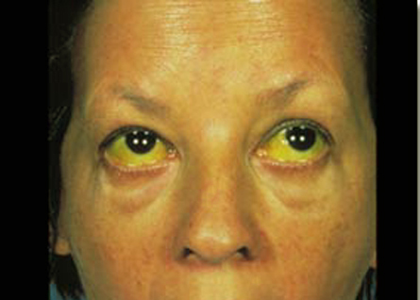
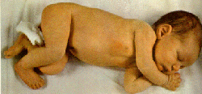

Slide 28
Causes:
1.Prehepatic jaundice
Due to excess RBC destruction(hemolysis)
2.Hepatic jaundice
Due to hepatocyte destruction and diffuse of bilirubin to serum
3.Post hepatic
Due to obstruction of bile canaliculi and reflux back of bile pigment to hepatocytes

Slide 29
